Slide 1
PYTHON AUTOMATION FOR STUDENT ADMINISTRATION
It is an automated computer based web application for college to maintain their students and staff information that should improve efficiency of the college/institute administration.

Slide 2
PROBLEM DEFINATION :
The College Management has to handle records for many number of students and staff maintain was difficult. Though it has used an information system, it was totally manual. Hence there is a need to upgrade the system with automated computer based web application.
EXISTING SYSTEM :
Basically there isn’t computerization of all the cases are handled by the college system. It follows book system and letter system, it means everything is handled or recorded in the books. There is a huge chance of loss of data or there may be some situations that which causes the loss of data.

Slide 3
PROPOSED SYSTEM :
Proposed system is an automated computer based web app. In this website you can find all the details of students, staff, courses, subjects and marks with other details of sections, sessions, leave permissions, feedback responses with enrolment numbers are maintained at a centralized location of the college admin software. It uses a centralized database for the information storage and security purpose. And it’s providing user-friendly interface also.

Slide 4
ABSTRACT :
The student administration system is the most integral and essential module of College. It provides a highly effective platform for automating & handling complete student information & administrative data and enhances institutional effectiveness. Details of students, staff, courses , subjects and marks with other details of sections, sessions and enrolment numbers are maintained at a centralized location of the College Admin software. To ease the administrative work hassles further, it allows the users to view and manage the data into Summary Chart Visualizations using plotting interfaces.

Slide 5
Modules :
1. Admin Module :
See Overall Summary Charts of Students Performances, Staff Performances, Courses, Subjects, Leave, etc.
Manage Students (Add, Update and Delete)
Manage Staff (Add, Update and Delete)
Manage Course (Add, Update and Delete)
Manage Subjects (Add, Update and Delete)
Manage Sessions (Add, Update and Delete)
View Student Attendance
Review and Reply Student/Staff Feedback
Review (Approve/Reject) Student/Staff Leave

Slide 6
2. Staff Module :
See the Overall Summary Charts related to their students, their subjects, leave status, etc.
Take/Update Students Attendance
Add/Update Result
Apply for Leave
Send Feedback to HOD

Slide 7
3. Student Module :
See the Overall Summary Charts related to their attendance, their subjects, leave status, etc.
View Attendance
View Result
Apply for Leave
Send Feedback to HOD

Slide 8
Software Requirements:
Front-end : UI Technologies (HTML, CSS, JS)
Back-end : Python
Frameworks : Django
Database : MySQL,Sqlite3
Hardware Requirements:
2GB Ram
4 MB Cache Memory
Hard disk 500 GB
Intel i3 (Processor)

Slide 9
Advantages:
Student & Staff Registrations are done by HOD(Admin)
Online Results configurations
Online Attendance integration
Course and Section allotments' are automated
User-Friendly Interface
Secure & Fast access to database
Less Server issues
Manual administrations are automated.
Disadvantages:
Passwords Allocation done by admin
Not Deployed into live server / Static Web Interface
Use of Smartphone or computer can operate this s/w
Cost-efficient for choosing proper server.

Slide 10
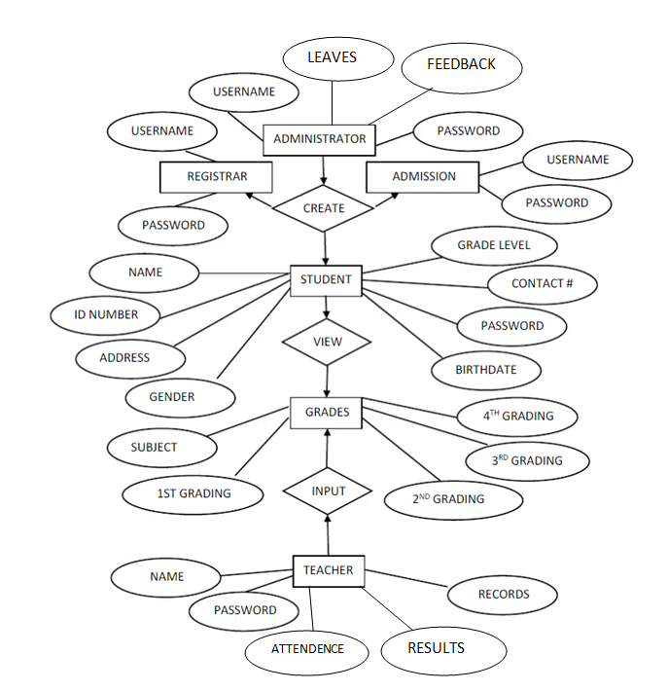
ER-Diagram of Student-Administration

Slide 11
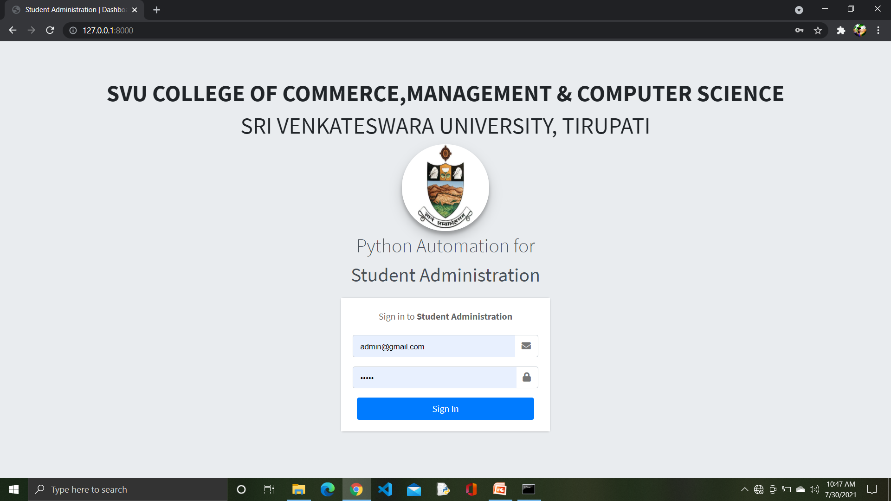
Output Screens

Slide 12
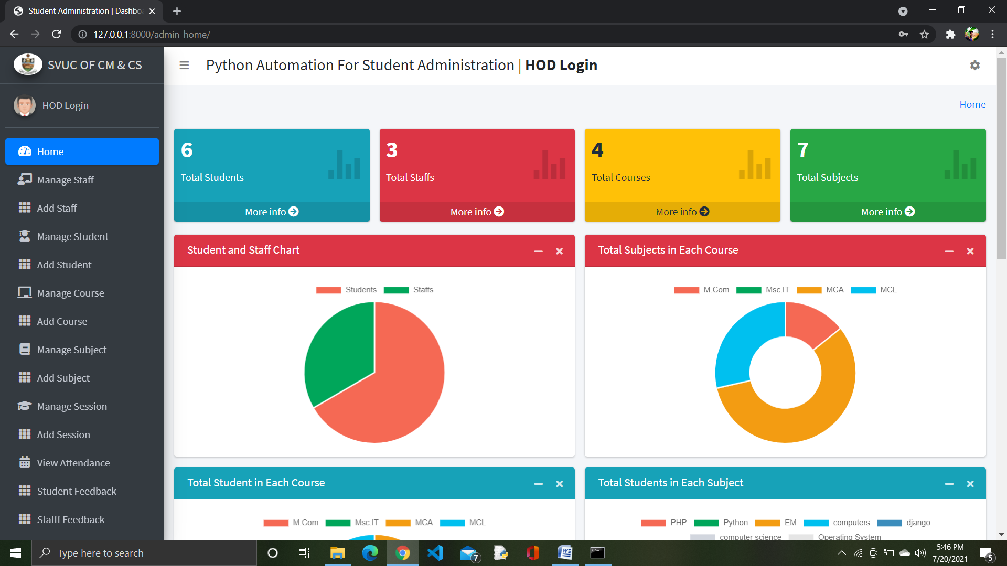

Slide 13
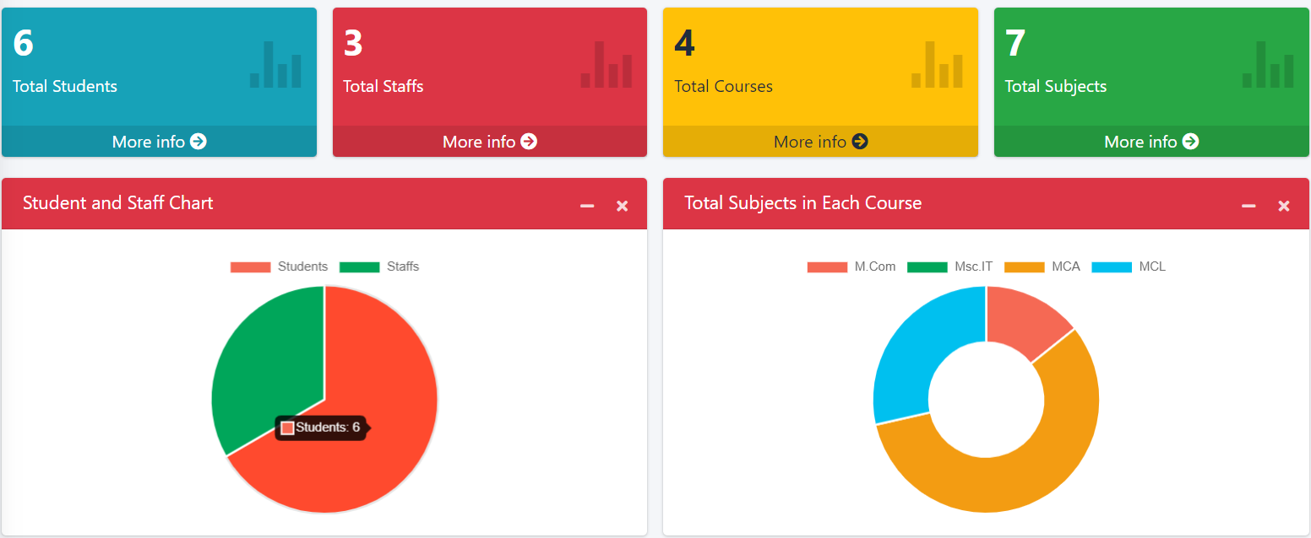
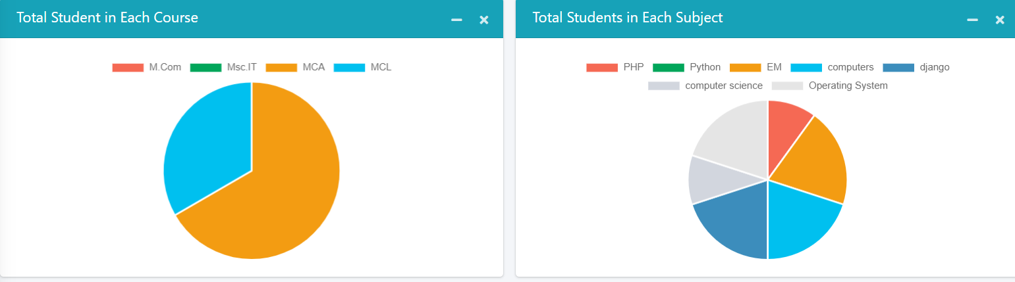
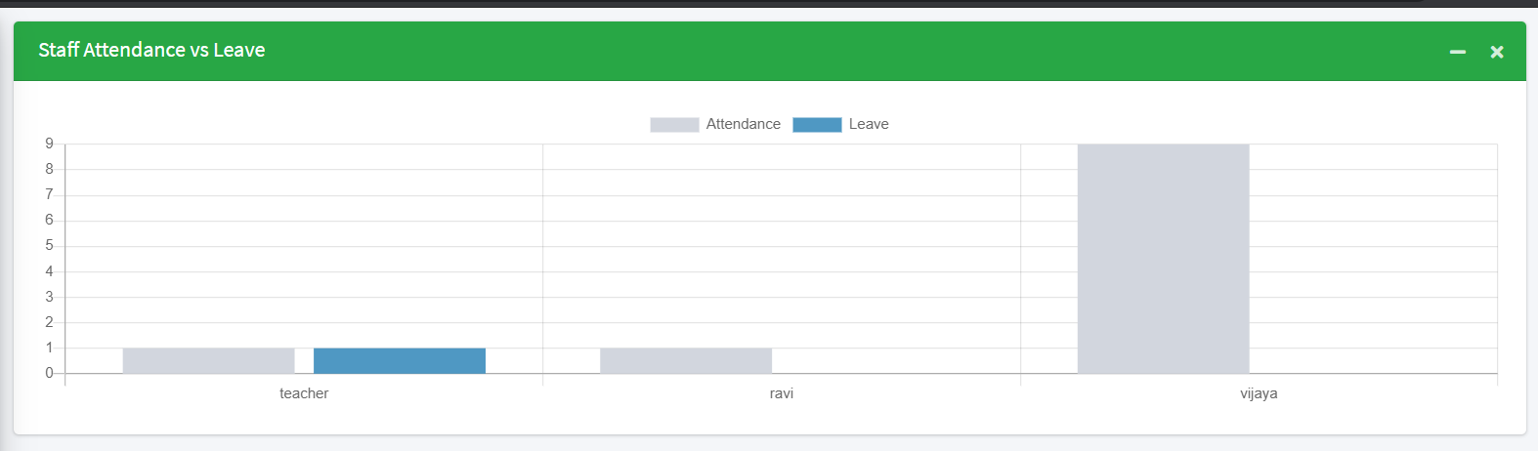
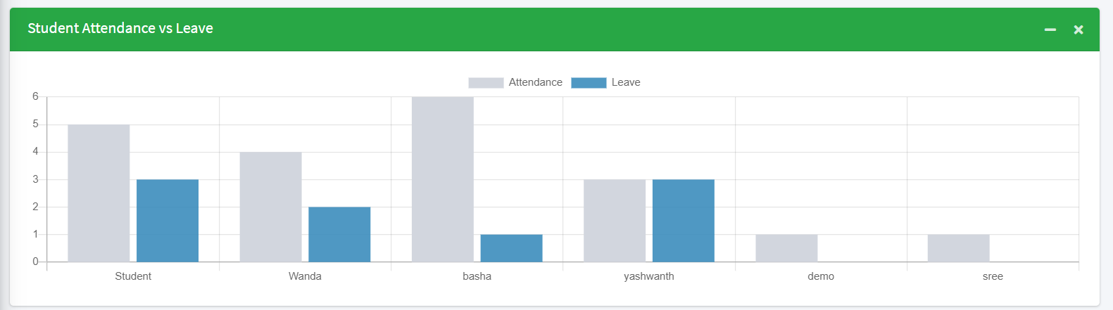

Slide 14
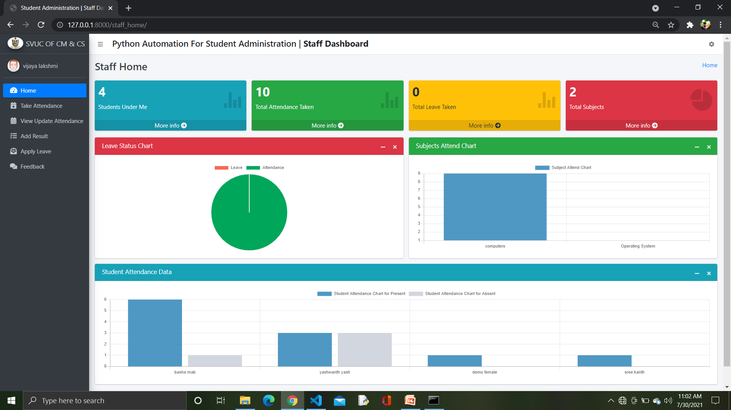

Slide 15
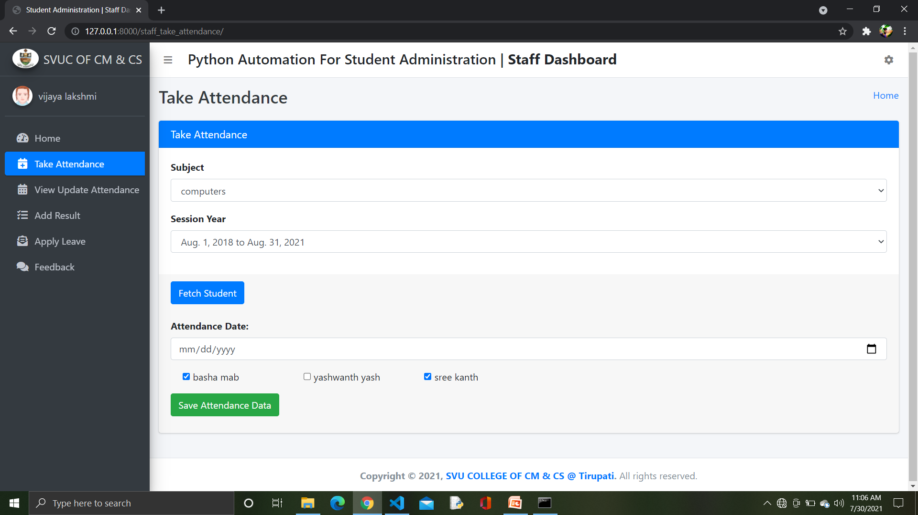

Slide 16
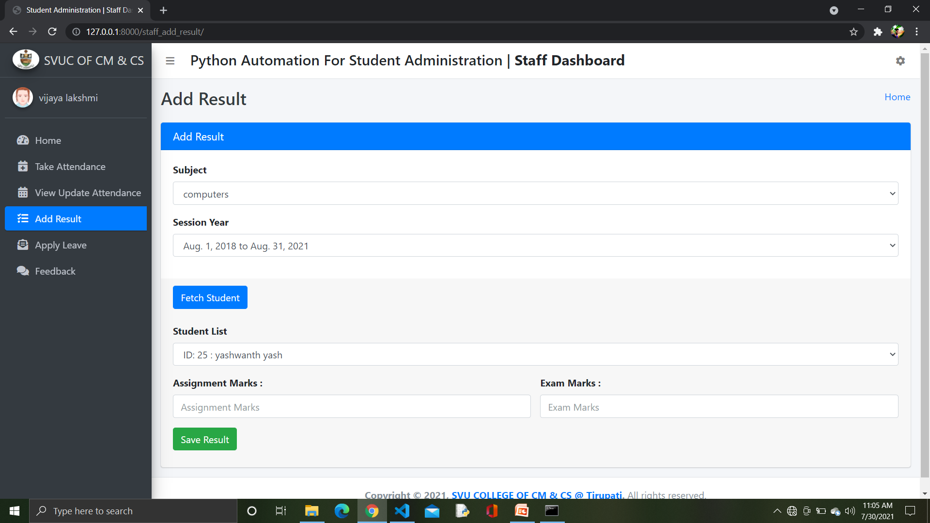

Slide 17
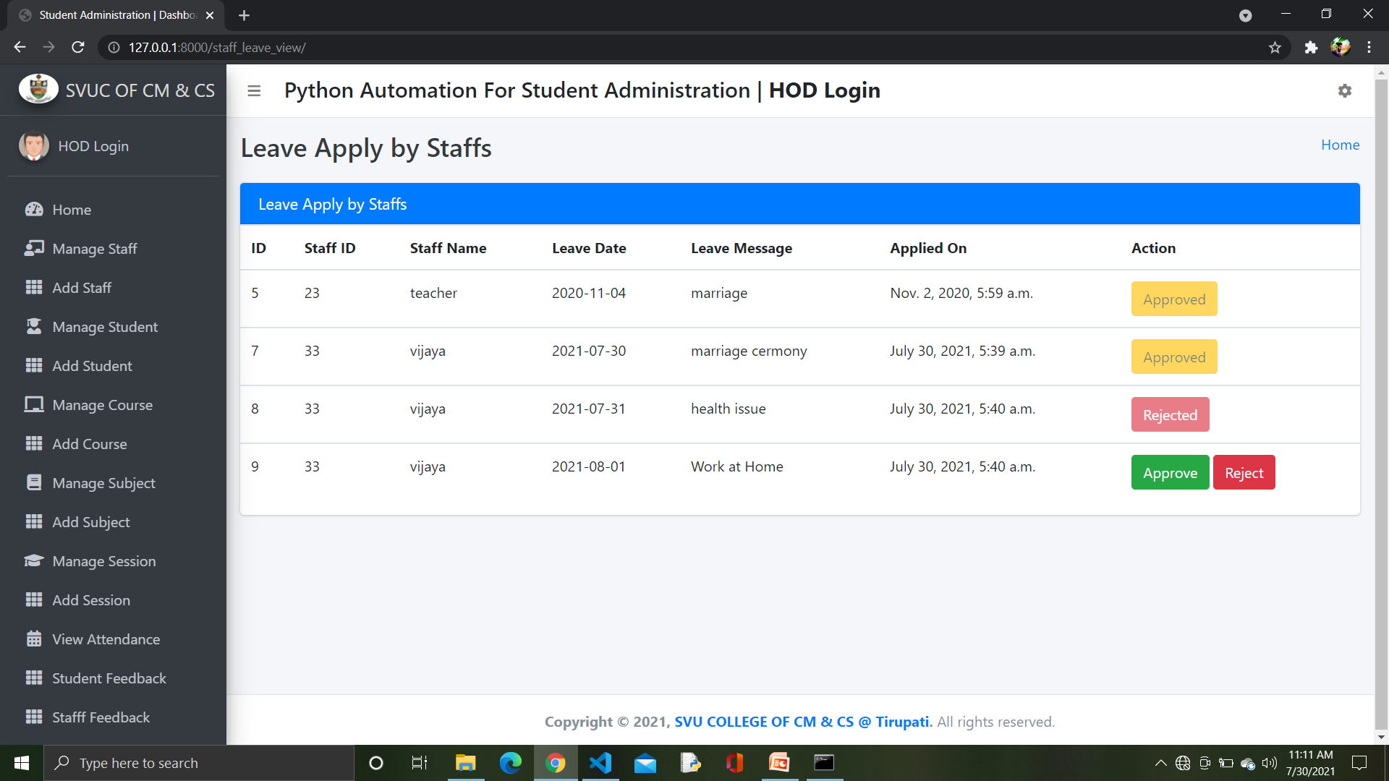
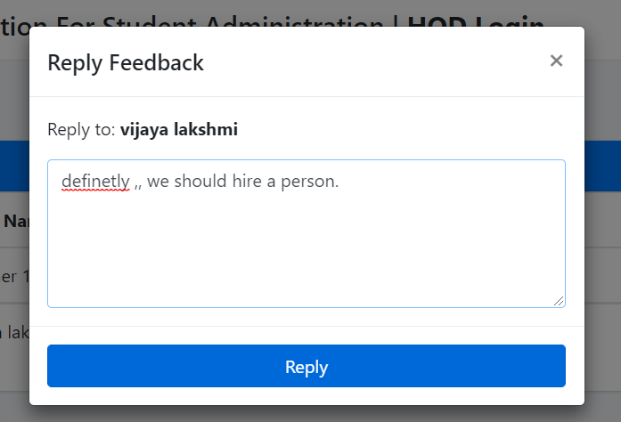
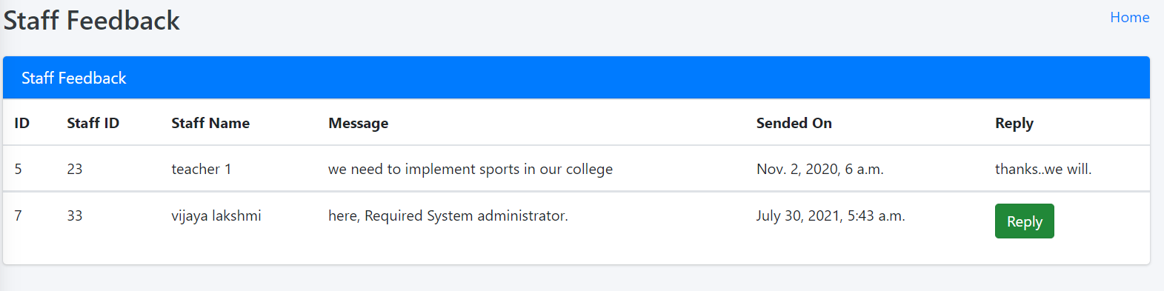

Slide 18
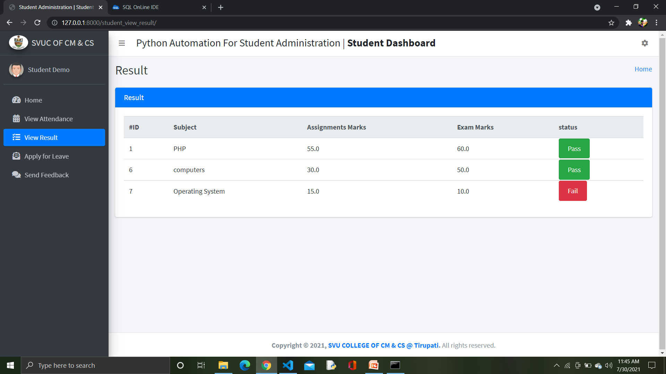
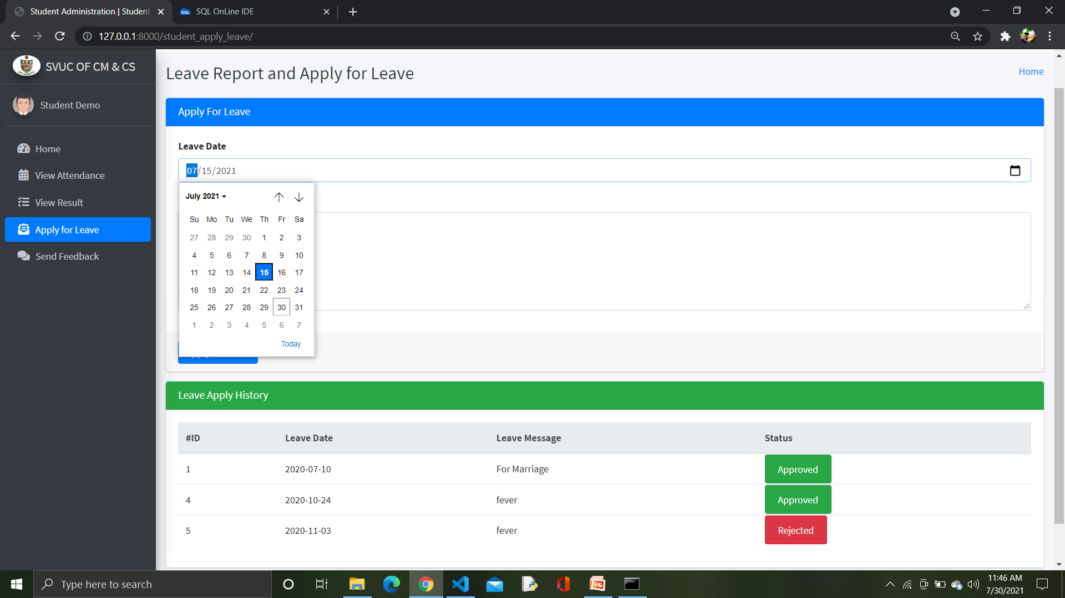

Slide 19
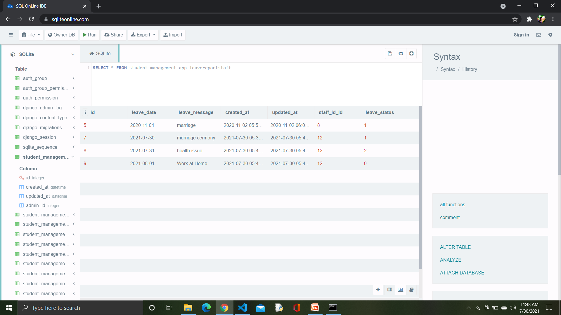
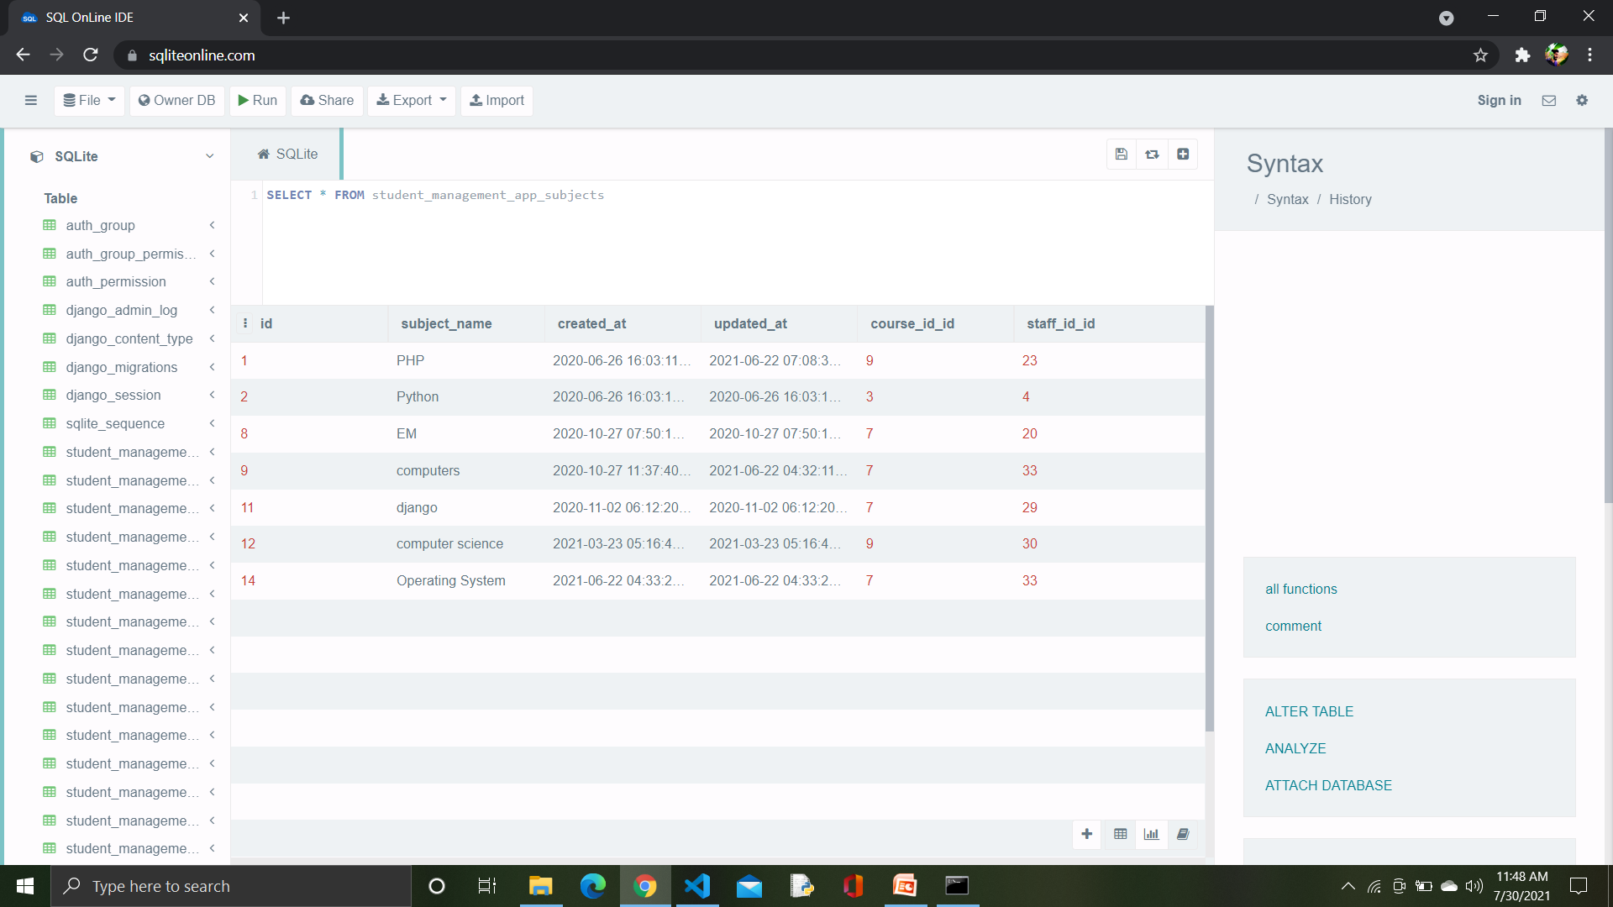

Slide 20
Conclusion :
This Automated Student Administration Software can be used by educational institutions to maintain their student records easily. Achieving this objective is difficult using the manual system as the information is scattered, It helps the college to achieve the target, reduce work, increase efficiency, eliminating error, and monitoring progress.. All these problems are solved by this project.

Slide 21
Thank You

